Slide 1

CCE 313 - Computer Networks
Analyzing DNS Queries with Wireshark
[Your Name] | [Your Student ID]
B.Sc. CSE, 5th Semester | November 17, 2025

Slide 2



Introduction: The Core Problem
The Problem: Names vs. Numbers
The Solution: DNS
As humans, we remember names, like google.com.
The Domain Name System (DNS) is the "phonebook of the internet."
Computers and networks, however, communicate using numbers—IP addresses—like 142.250.190.78.
It's a global, distributed database system that translates human-friendly domain names into the machine-readable IP addresses required for network communication.
How does your browser find the right computer on the internet just by using a name?

Slide 3
Why This Topic is Important
Foundation of the Internet: Nearly every internet action—browsing, sending an email, or playing a game—starts with a DNS query.
Troubleshooting: Network engineers often say, "It's always DNS." Analyzing queries helps diagnose network failures (e.g., "server not found").
Security: DNS traffic is often unencrypted. Analyzing it can reveal security threats, like malware communicating with a "Command & Control" server.
Performance: Slow DNS resolution directly translates to slow website loading. Analysis helps identify and fix these performance bottlenecks.

Slide 4






Core Content: Our Toolkit & Process
1. The Tool: Wireshark
2. The Test: nslookup
3. The Process: Capture & Filter
A free, open-source packet analyzer. It captures and displays all network traffic, allowing us to see individual protocols like DNS in action.
We will use the simple command-line tool nslookup (or just visit a website) to generate live DNS traffic for us to capture.
We will: 1. Start a Wireshark capture. 2. Run our test. 3. Stop the capture. 4. Apply the display filter "dns".

Slide 5

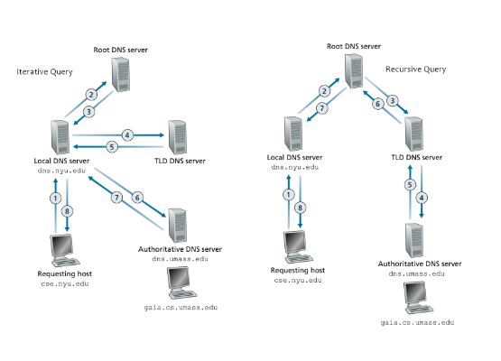
Core Content: The DNS Query Process
•
Your PC sends a Recursive Query to a Local DNS Server (e.g., your router or ISP). It asks, "Where is google.com?"
•
The Local Server takes responsibility and performs Iterative Queries.
•
It asks a Root Server, which points to the TLD Server (for .com).
•
The TLD Server points to the Authoritative Server (for google.com).
•
This server provides the final IP, which is sent all the way back to your PC.

Slide 6


Core Content: DNS Records & Protocol
Key Record Types
The Transport Protocol: UDP
•
A Record: Maps a name to an IPv4 address (e.g., 1.2.3.4).
DNS primarily uses UDP (User Datagram Protocol) on Port 53.
•
AAAA Record: Maps a name to an IPv6 address.
Why UDP? It's fast, low-overhead, and connectionless. A single request and its response can fit in one packet each, which is highly efficient.
•
CNAME: (Canonical Name) An alias that points to another domain name.
•
MX: (Mail Exchange) Specifies the mail servers for a domain.
(TCP is only used for large transfers, like a full zone transfer, not standard queries).

Slide 7
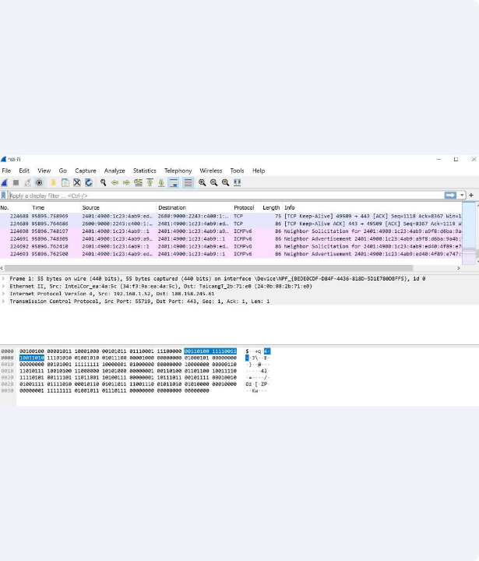
Analysis: Live Wireshark Capture
This is the main Wireshark interface after capturing traffic.
•
We have applied the "dns" display filter at the top.
•
We can clearly see the packet list, showing the "Standard query" and "Standard query response".
•
The "Info" column gives us a quick summary of each packet.
•
We can see the Source (our PC) and Destination (the DNS server).

Slide 8
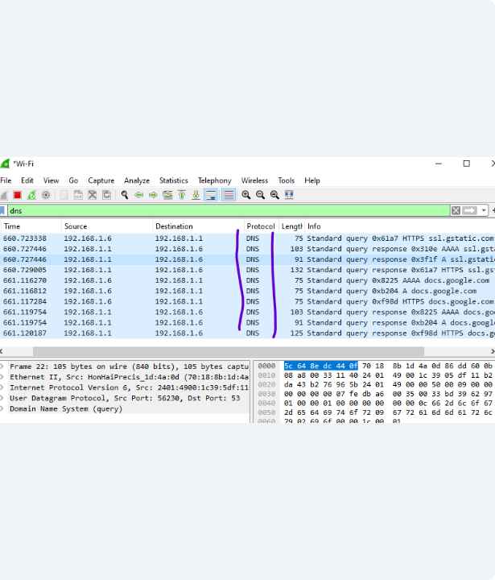
Analysis: Dissecting the Query Packet
Here, we have selected the first packet—the query from our PC.
•
In the packet details pane (middle), we can expand the "Domain Name System (query)" section.
•
We can see the flags indicating it is a "Standard query".
•
Under "Queries", we see the name we are looking for: www.google.com.
•
It specifies we are asking for a Type A record (an IPv4 address).

Slide 9
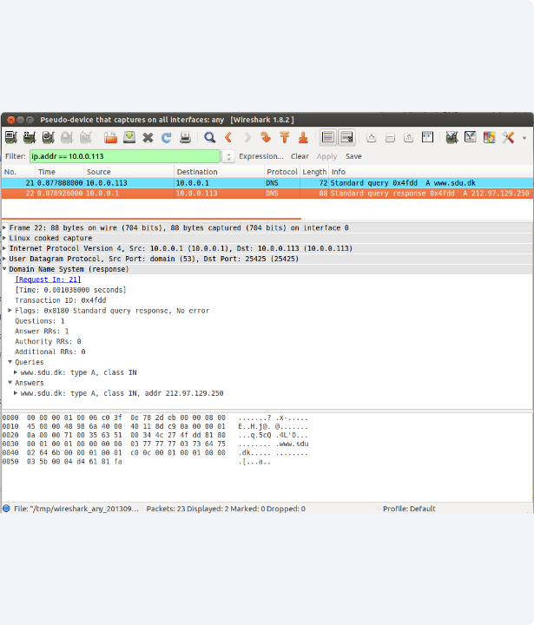
Analysis: Dissecting the Response Packet
Now, we select the second packet—the response from the DNS server.
•
The "Info" column shows "Standard query response".
•
In the packet details, we expand the "Answers" section.
•
The server has provided the answer: Name: www.google.com Type: A (IPv4) Address: 142.250.190.78
•
This is the IP address our browser needs!

Slide 10
Analysis & Practical Implications
<50ms
What We Found
Performance: The entire process—from query to response—is incredibly fast, often taking less than 50 milliseconds. This speed is essential for a fast-feeling internet.
Typical Query Time
Security: We also confirmed that this DNS traffic is sent in clear text. Anyone on the network can see what websites you are looking up. This major privacy flaw is why new protocols like DNS-over-HTTPS (DoH) were invented.

Slide 11
Conclusion
Summary: DNS is the essential translation service of the internet, turning names into IPs. Takeaway: Wireshark is a powerful, practical tool that makes this complex "invisible" protocol visible, allowing us to analyze the query/response flow, diagnose issues, and understand its performance.

Slide 12
Thank You
Questions?
Key References: Forouzan, B. A. (2012). Data Communications and Networking. Kurose, J. F., & Ross, K. W. (2021). Computer Networking: A Top-Down Approach. Official Wireshark Documentation (wireshark.org)

